Slide 1
Indexing Local Features
Slides adapted from Kristen Grauman, David Nister, Bastian Leibe

Slide 2
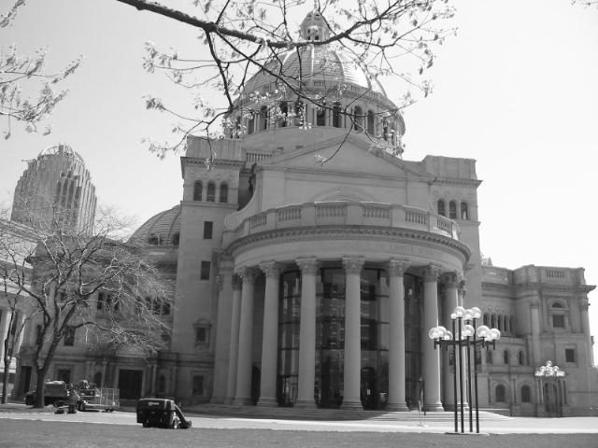
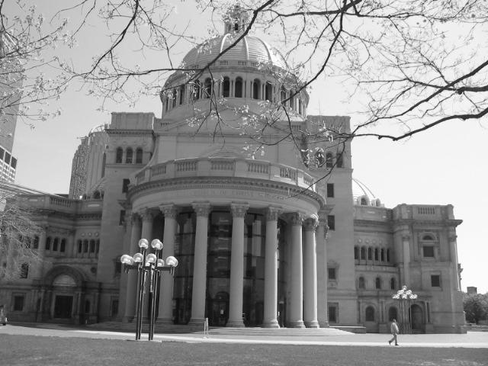
Matching Local Features
Goal: Match local regions in two images
Last class: local features
Interest operator: location, scale, orientation
Feature descriptor

Slide 3
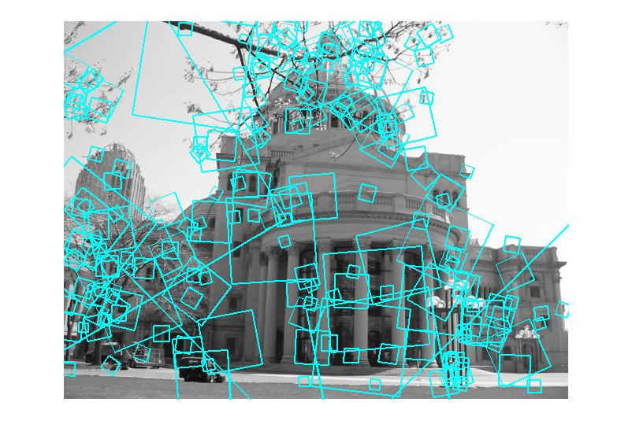
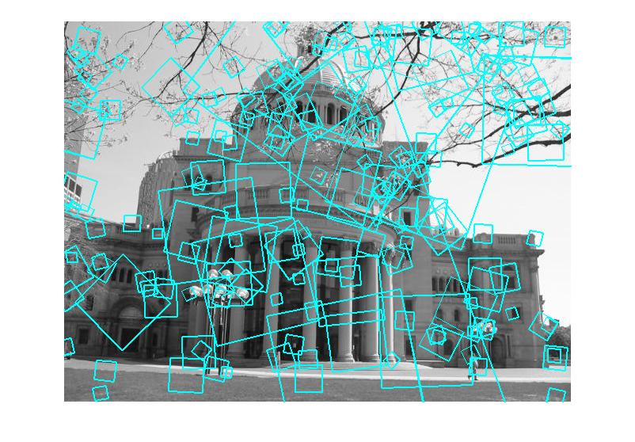
Matching local features
?
Image 1
Image 2
To generate candidate matches, find patches that have the most similar appearance (e.g., lowest SSD)
Simplest approach: compare them all, take the closest (or closest k, or within a thresholded distance)

Slide 4
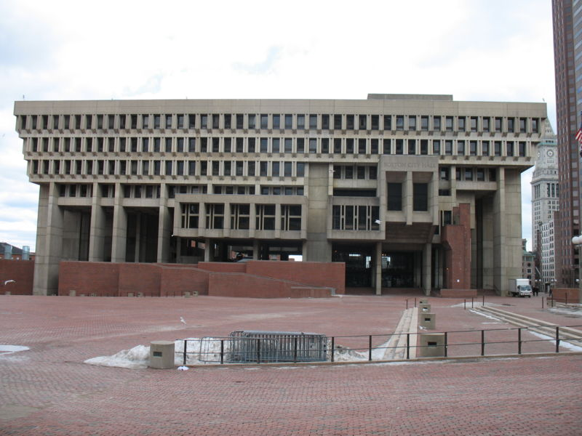
Indexing Local Features
…

Slide 5
Features as High Dimensional Points
Each patch / region has a descriptor (e.g., SIFT)
Think of each feature as a point in a high-dimensional feature space
128 dimensions for SIFT
Descriptor’s feature space
Notes:
5

Slide 6
Indexing local features
When we see close points in feature space, we have similar descriptors, which indicates similar local content
Query image
Descriptor’s feature space
Database images

Slide 7
Efficiently Matching Images?
Internet-scale image matching
Thousands of features per image
Millions (to Billions) of images to search
How do we efficiently find relevant matching images?
Search engines have been doing this a long time for text documents
Let’s borrow some of those ideas…
Notes:
7

Slide 8
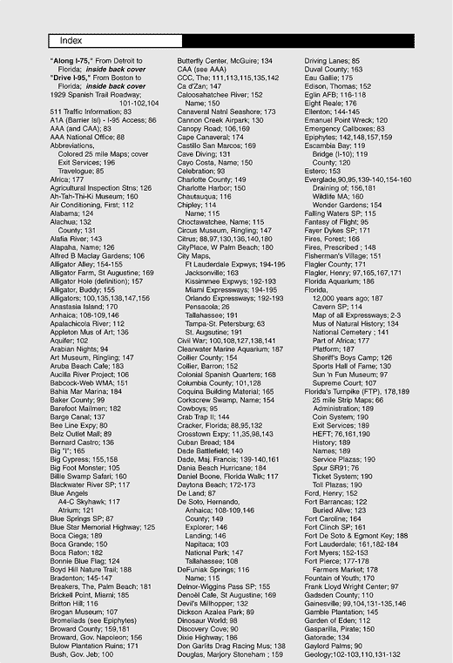
Inverted File Index
For text documents, an efficient way to find all pages on which a word occurs is to use an index…
We want to find all images in which a feature occurs.
To use this idea, we’ll need to map our features to “visual words”.

Slide 9
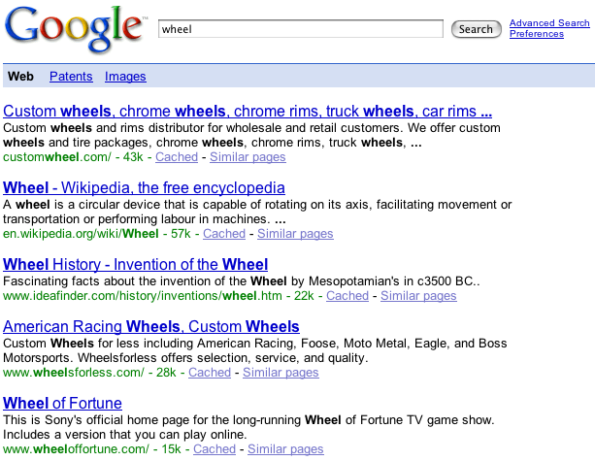
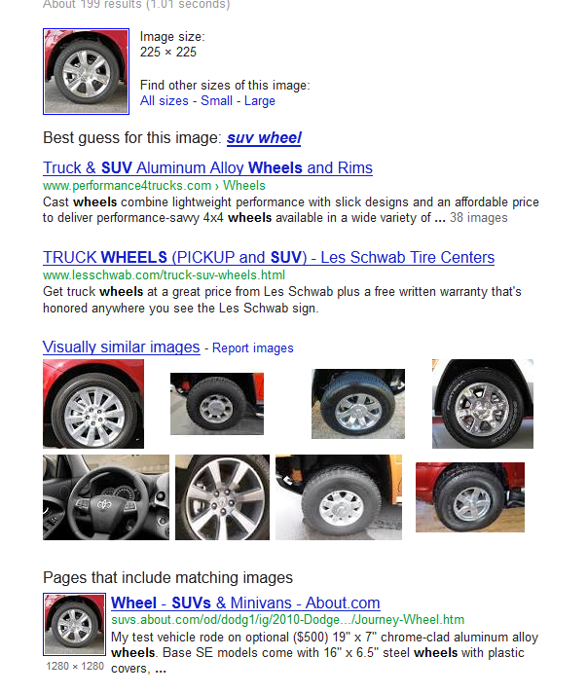
Text retrieval vs. image search
What makes the problems similar, different?
Google Image Search for this picture
Google search for “wheel”

Slide 10
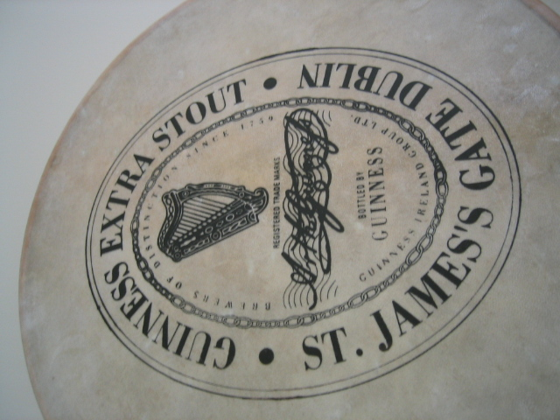
Visual Words
Extract some local features from a number of images …
e.g., SIFT descriptor space: each point is 128-dimensional

Slide 11
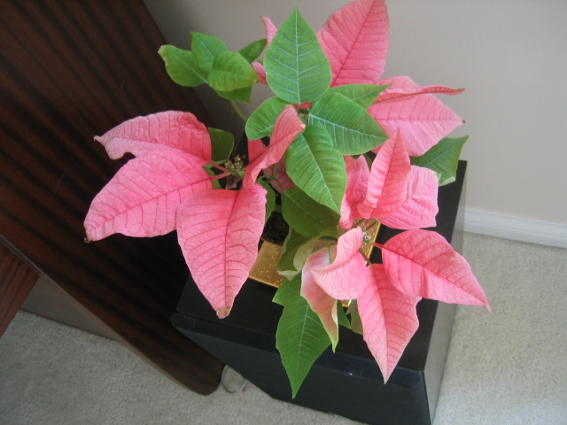
Visual Words

Slide 12
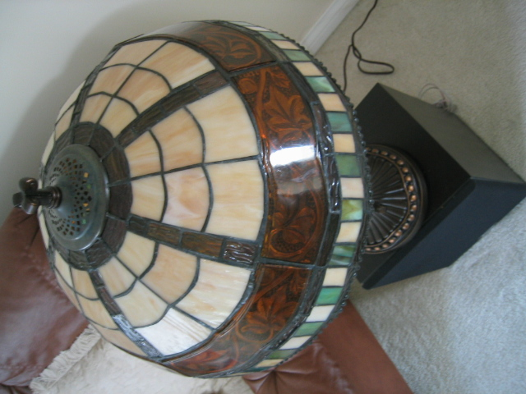
Visual Words

Slide 13

Visual Words

Slide 14
Each point is a local descriptor, e.g. SIFT vector.

Slide 16
Vector Quantization
Map high-dimensional descriptors to tokens/words by quantizing the feature space
Based on clustering (e.g., k-means)
Quantize via clustering, let cluster centers be the prototype “words”
Word #2
Determine which word to assign to each new image region by finding the closest cluster center
Descriptor’s feature space

Slide 17
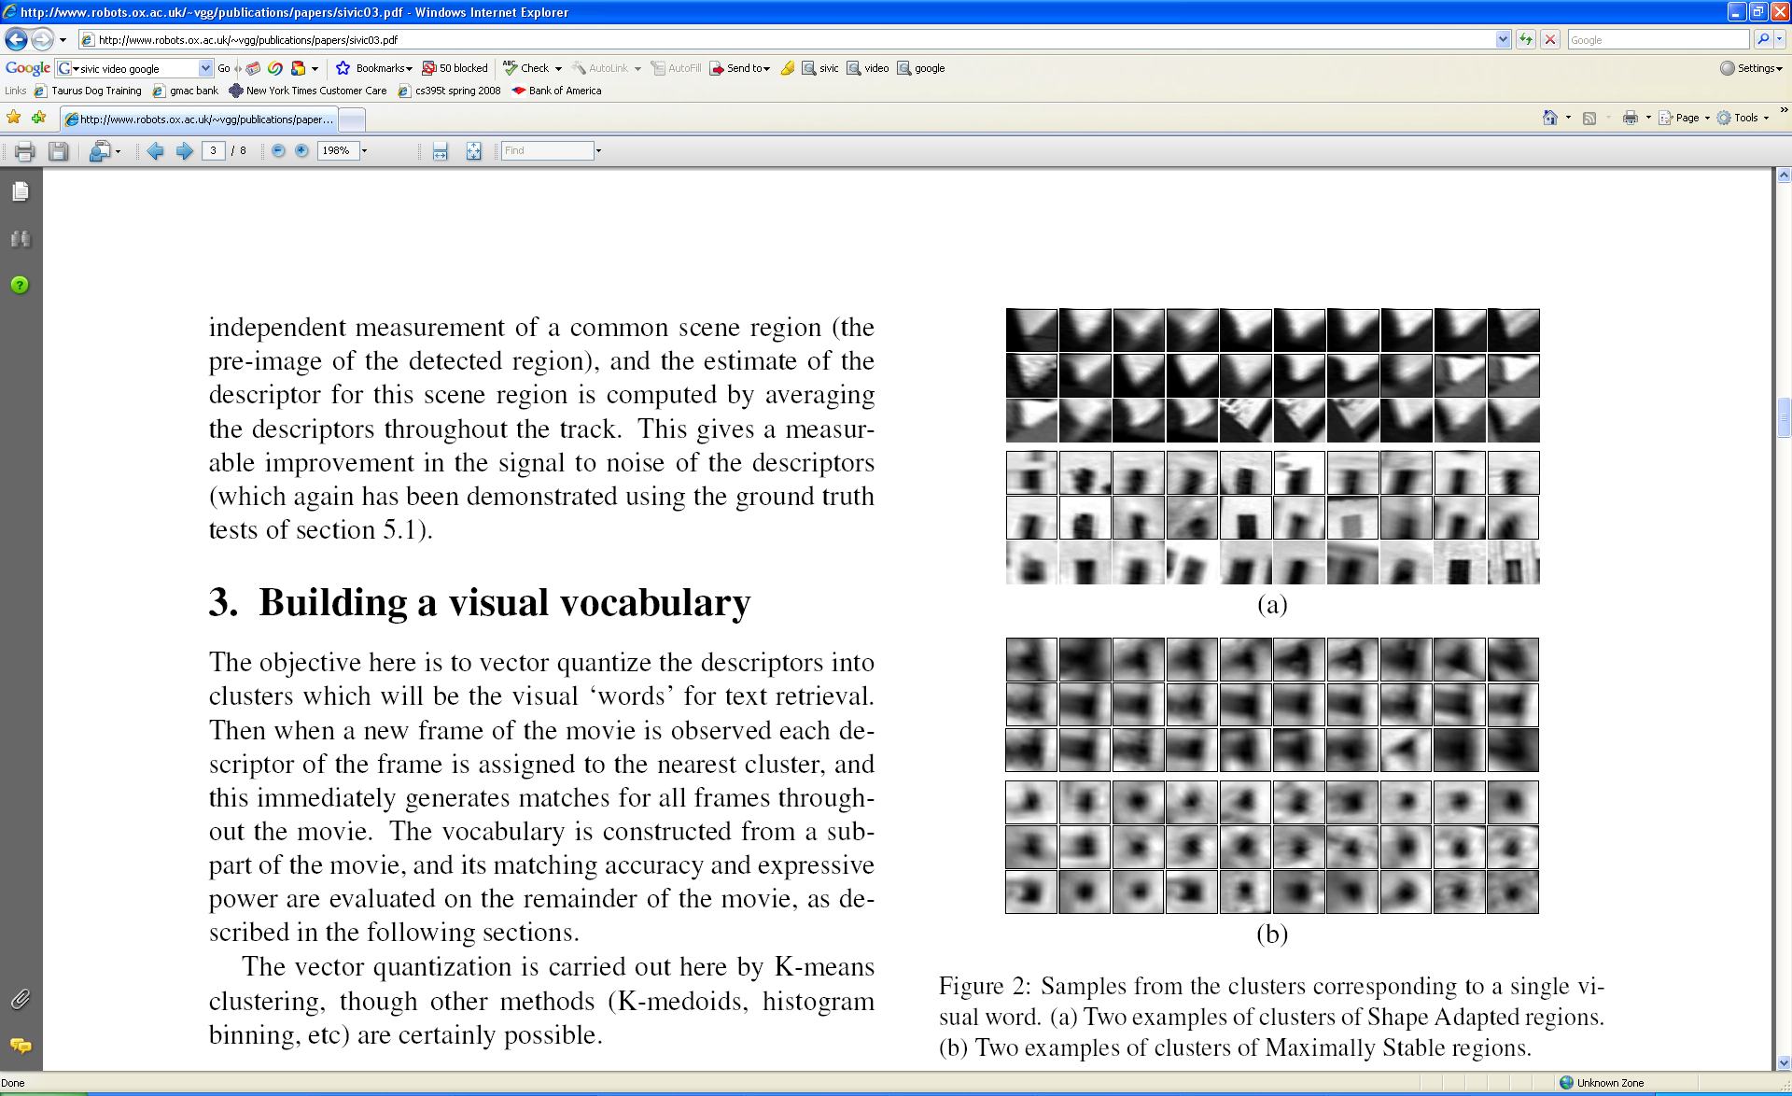
Visual Words
Example: each group of patches belongs to the same visual word
Figure from Sivic & Zisserman, ICCV 2003

Slide 18
Forming a Visual Vocabulary
What set of visual words make up a visual vocabulary?
What issues need to be considered?
Sampling strategy: where to extract features?
Interest point operator? Grid of locations in an image?
Clustering / quantization algorithm
Unsupervised vs. supervised
Should we specify which features should be in the same word? (or let clustering algorithm figure it out?)
What corpus provides features (universal vocabulary?)
Features from cars, buildings may not be good for matching nature images
Vocabulary size, number of words

Slide 19
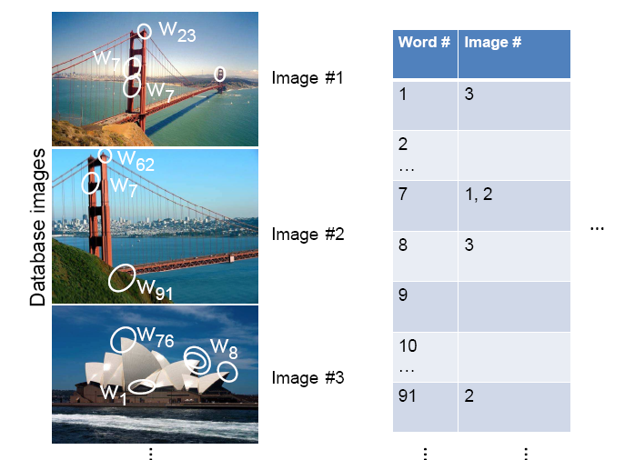
Inverted file index
Database images are loaded into the index mapping words to image numbers

Slide 20
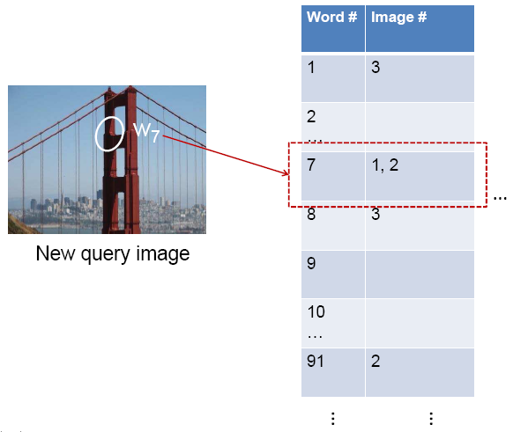
Inverted file index
When will this give us a significant gain in efficiency?
New query image is mapped to indices of database images that share a word.

Slide 21
Representing Images
If a local image region is a visual word, how can we summarize an image (the document)?

Slide 22

Analogy to documents
Of all the sensory impressions proceeding to the brain, the visual experiences are the dominant ones. Our perception of the world around us is based essentially on the messages that reach the brain from our eyes. For a long time it was thought that the retinal image was transmitted point by point to visual centers in the brain; the cerebral cortex was a movie screen, so to speak, upon which the image in the eye was projected. Through the discoveries of Hubel and Wiesel we now know that behind the origin of the visual perception in the brain there is a considerably more complicated course of events. By following the visual impulses along their path to the various cell layers of the optical cortex, Hubel and Wiesel have been able to demonstrate that the message about the image falling on the retina undergoes a step-wise analysis in a system of nerve cells stored in columns. In this system each cell has its specific function and is responsible for a specific detail in the pattern of the retinal image.
China is forecasting a trade surplus of $90bn (£51bn) to $100bn this year, a threefold increase on 2004's $32bn. The Commerce Ministry said the surplus would be created by a predicted 30% jump in exports to $750bn, compared with a 18% rise in imports to $660bn. The figures are likely to further annoy the US, which has long argued that China's exports are unfairly helped by a deliberately undervalued yuan. Beijing agrees the surplus is too high, but says the yuan is only one factor. Bank of China governor Zhou Xiaochuan said the country also needed to do more to boost domestic demand so more goods stayed within the country. China increased the value of the yuan against the dollar by 2.1% in July and permitted it to trade within a narrow band, but the US wants the yuan to be allowed to trade freely. However, Beijing has made it clear that it will take its time and tread carefully before allowing the yuan to rise further in value.
sensory, brain,
visual, perception,
retinal, cerebral cortex,
eye, cell, optical
nerve, image
Hubel, Wiesel
China, trade,
surplus, commerce,
exports, imports, US,
yuan, bank, domestic,
foreign, increase,
trade, value
ICCV 2005 short course, L. Fei-Fei

Slide 23
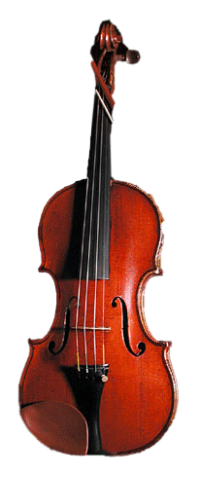
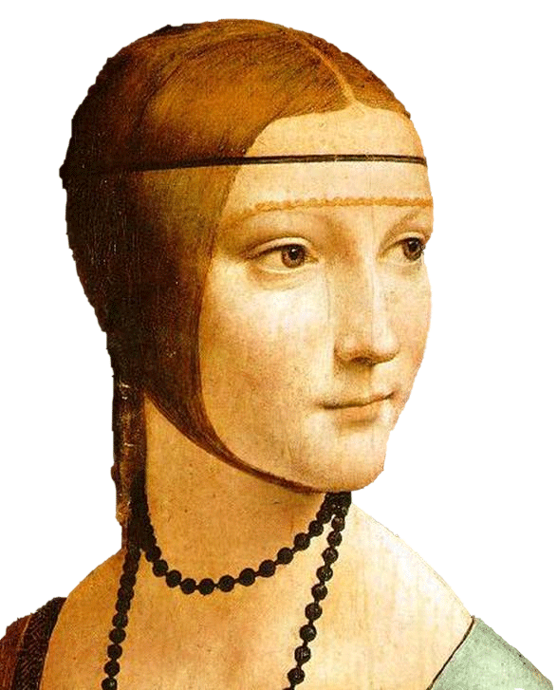
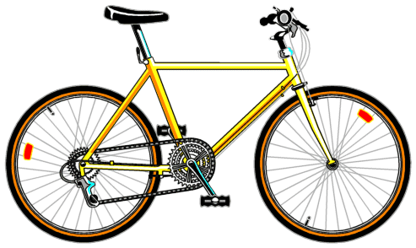
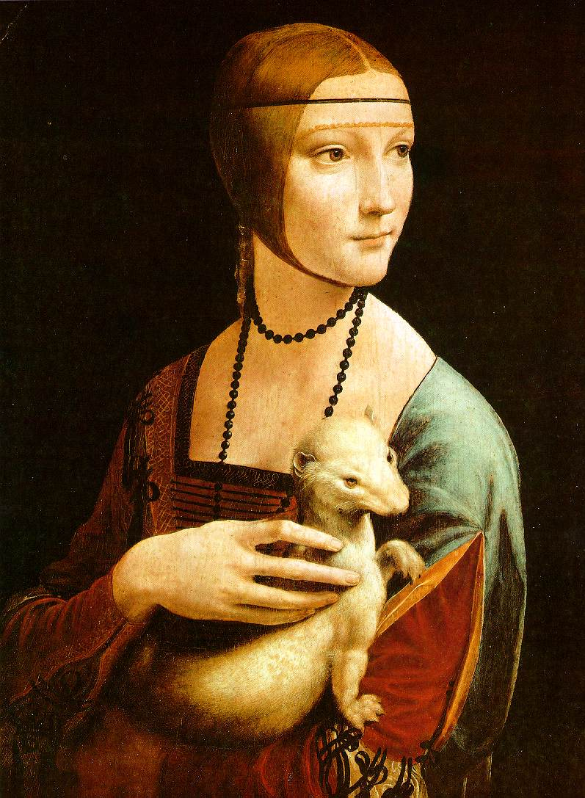

Slide 24
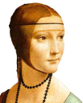
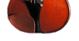
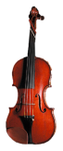
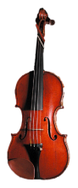

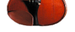

Bags of visual words
Summarize entire image based on its distribution (histogram) of word occurrences.
Analogous to bag of words representation commonly used for documents.
Notes:
24

Slide 25

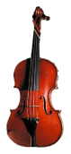



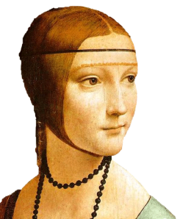
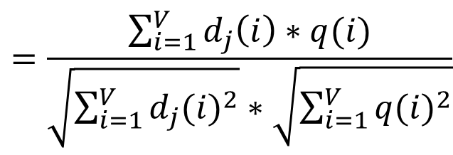
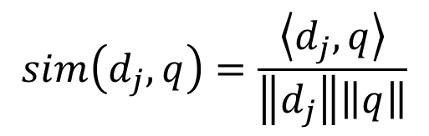
Comparing bags of words
Rank frames by normalized scalar product between their (possibly weighted) occurrence counts---nearest neighbor search for similar images.
[1 8 1 4]
[5 1 1 0]
$$sim\left(d_{j},q\right)=\frac{\left\langle d_{j},q\right\rangle }{\left\|d_{j}\right\|\left\|q\right\|}$$
$$=\frac{\sum_{i=1}^{V}{d_{j}\left(i\right)∗q(i)}}{\sqrt{\sum_{i=1}^{V}{{d_{j}(i)}^{2}}}∗\sqrt{\sum_{i=1}^{V}{{q(i)}^{2}}}}$$
for vocabulary of V words

Slide 26
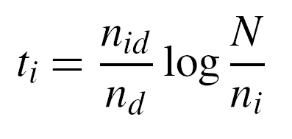
tf-idf weighting
Term frequency – inverse document frequency
Describe frame by frequency of each word within it, downweight words that appear often in the database
(Standard weighting for text retrieval)
Number of occurrences of word i in document d
Total number of documents in database
Number of documents word i occurs in, in whole database
Number of words in document d

Slide 27
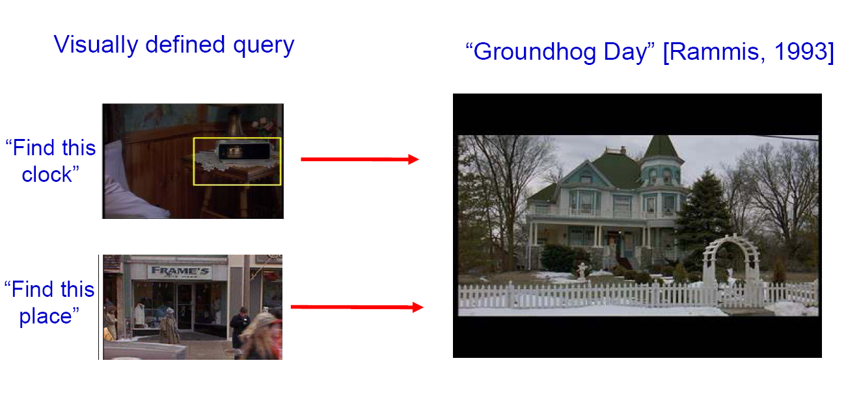
Bags of words for content-based image retrieval
Slide from Andrew Zisserman
Sivic & Zisserman, ICCV 2003

Slide 28
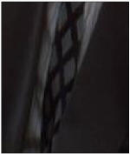
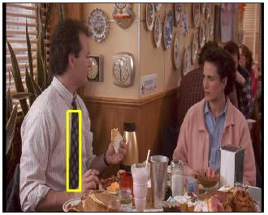
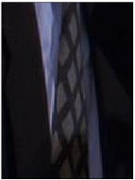
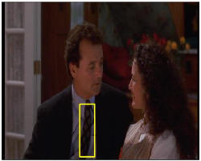
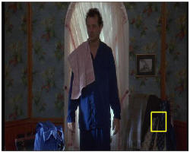
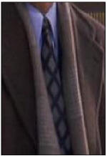
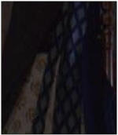
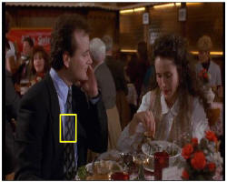
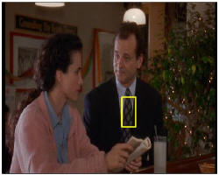
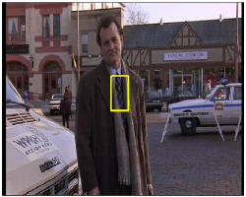
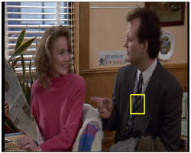
Video Google System
Query region
Collect all words within query region
Inverted file index to find relevant frames
Compare word counts
Spatial verification
Sivic & Zisserman, ICCV 2003
Online Demo http://www.robots.ox.ac.uk/~vgg/research/vgoogle/index.html
Retrieved frames
28
Notes:
28

Slide 29
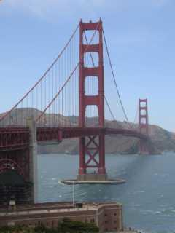
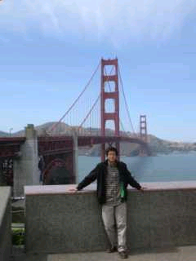
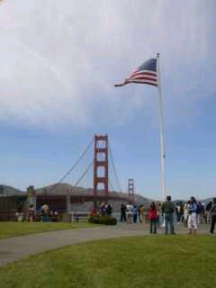
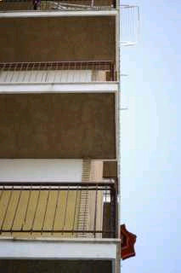
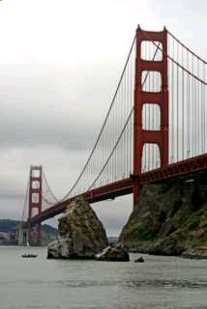
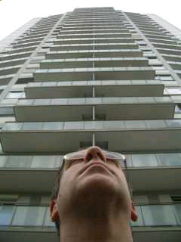
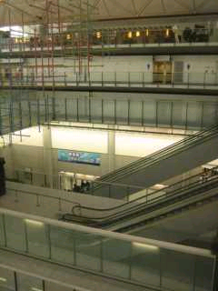
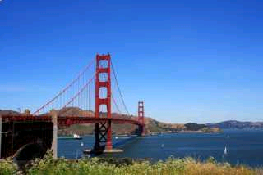

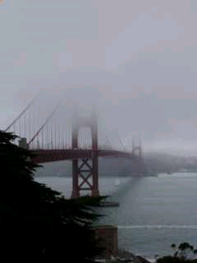
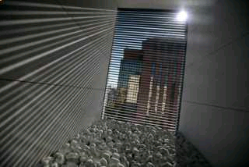
Scoring retrieval quality
Results (ordered):
Database size: 10 images
Relevant (total): 5 images
Query
precision = #relevant / #returned
recall = #relevant / #total relevant
1
0.8
0.6
precision
0.4
0.2
0
0
0.2
0.4
0.6
0.8
1
recall
Slide credit: Ondrej Chum

Slide 30
Vocabulary Trees: hierarchical clustering for large vocabularies
[Nister & Stewenius, CVPR’06]
Tree construction:

Slide 31
Vocabulary Tree
[Nister & Stewenius, CVPR’06]
Training: Filling the tree

Slide 32


Vocabulary Tree
[Nister & Stewenius, CVPR’06]
Training: Filling the tree

Slide 33


Vocabulary Tree
[Nister & Stewenius, CVPR’06]
Training: Filling the tree

Slide 34


Vocabulary Tree
[Nister & Stewenius, CVPR’06]
Training: Filling the tree

Slide 35


Vocabulary Tree
What is the benefit of this tree-based approach?
[Nister & Stewenius, CVPR’06]
Training: Filling the tree

Slide 36

Vocabulary Tree
Verification (later step)
[Nister & Stewenius, CVPR’06]
Recognition

Slide 37
Bags of words: pros and cons
+ flexible to geometry / deformations / viewpoint
+ compact summary of image content
+ provides vector representation for sets
+ very good results in practice
background and foreground mixed when bag covers whole image
optimal vocabulary formation remains unclear
basic model ignores geometry – feature matches aren’t enough, how they are laid out is important
must verify matches afterwards (next class)
Notes:
37

Slide 38
Summary
Matching local invariant features useful to find objects and scenes
Bag of words: quantize feature space to make discrete set of visual words
Summarize image by distribution of words
Index individual words
Inverted index: pre-compute index to enable faster search at query time

